Slide 1

Bank Telemarketing Campaign Analysis
This presentation outlines the key findings and recommendations from my analysis of a telemarketing campaign dataset. We examined various aspects including data imputation, feature engineering, descriptive statistics, correlation analysis, customer demographics, financial behaviors, and campaign performance to derive actionable insights for improving campaign effectiveness.
VS
by Vikas Singh

Slide 2
Data Preparation and Feature Engineering
I tackled null values using appropriate methods: median for age (continuous and right-skewed), mode for month and response (categorical). The duration column was standardized to minutes and converted to float type. We split the jobedu column into separate job and education columns. The month column was split into month name and year, then combined with day to create a datetime format date column.
Age
20 nulls
50 nulls
Month
Response
30 nulls
Continuous variables like age, balance, and salary were categorized for easier interpretation. Categorical variables were encoded to enable mathematical calculations and correlation analysis with the target variable (response).
1
Data Imputation
Used median for age, mode for month and response
2
Feature Engineering
Standardized duration, split jobedu and month columns
3
Variable Encoding
Categorized continuous variables, encoded categorical variables
Vikas Singh

Slide 3
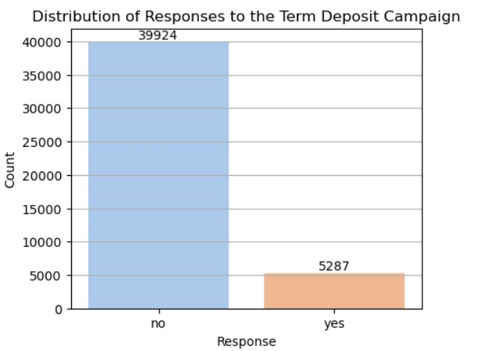
Descriptive Statistics and Distribution Analysis
My analysis revealed right-skewed distributions for most columns, except for salary which was left-skewed. There was substantial variability in feature values, particularly for day and duration. Campaign and previous showed lower dispersion within the middle 50% of values.
The campaign responses were significantly imbalanced, with 88.31% "no" responses and only 11.69% "yes" responses. This indicates a need for a root cause analysis and targeted improvements in the campaign strategy.
Right-Skewed
High Variability
Most columns showed right-skewed distribution
Substantial variability in feature values, especially day and duration
Response Analysis
1
Overall Response Rate (Highly Imbalance Data)
11.69% positive responses (Yes), 88.31% negative responses (No).
2
Key Factors
Duration of interaction is the strongest predictor of positive response.
3
Weak Correlations
Age, salary, and balance have minimal impact on response rates.

Slide 4
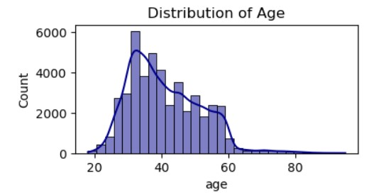
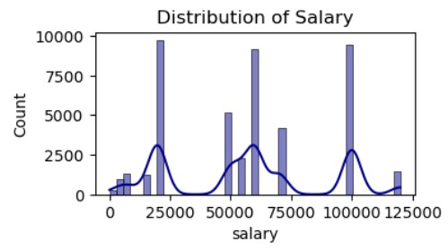
Age and Salary Distribution Analysis
The age distribution was right-skewed, with most individuals aged between 20-50 and peaking around 30-40. Several outliers were observed above 60, extending towards 80+. Middle-aged customers show highest response rates. For salary, we found a multimodal distribution with noticeable peaks, indicating possible salary bands or structured groups. The salary range was broad without extreme outliers.
Recommendations include addressing age outliers if not relevant, analyzing age groups separately, and investigating the reasons behind salary clusters to tailor marketing strategies accordingly.
Age Distribution
Right-skewed, peak at 30-40, outliers above 60
Salary Distribution
Multimodal, possible salary bands, broad range without extreme outliers
Recommendations
Address age outliers, analyze age groups separately, investigate salary clusters

Slide 5
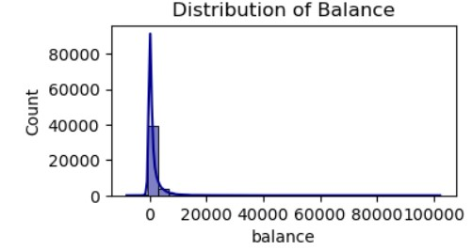

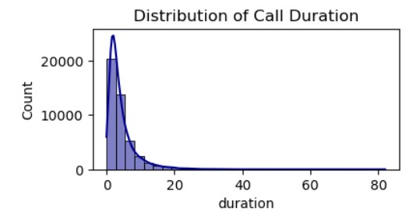


Balance and Duration Distribution Analysis
The balance distribution showed a majority of very low balances, with a few high outliers and some negative balances. This suggests a need for different account tiers and programs to encourage higher minimum balances.
Call durations were mostly short, clustered around 0-10 minutes, with few lasting longer. The data was right-skewed, with most calls under 6.6 minutes. Longer conversations tended to result in more conversions, indicating the importance of quality interactions.
Balance Distribution
Majority low balances, few high outliers
Call Duration
Mostly short, clustered 0-10 minutes
Conversion Insight
Longer calls tend to convert more
Vikas Singh

Slide 6
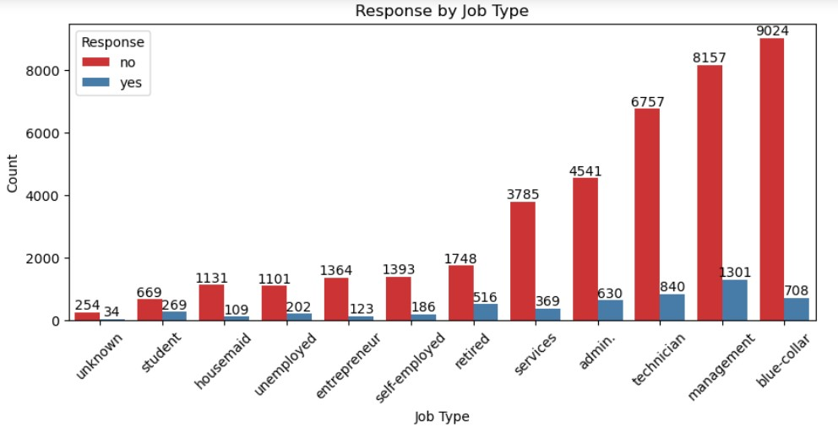
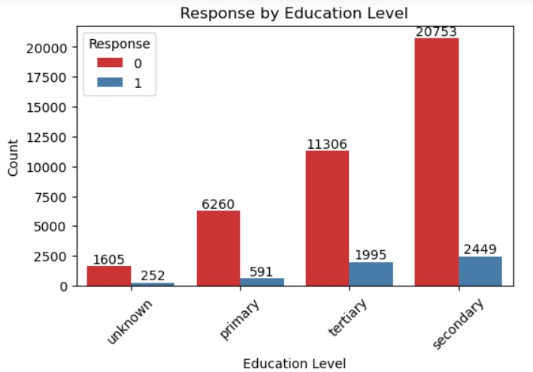
Job and Education Analysis
Blue-collar highest volume, lowest conversion ,Management second highest volume, best conversion and Technical moderate volume, good conversion. In education, Secondary education 23,202 customers, 10.5% conversion rate, Tertiary education 13,301 customers, having highest 15.0% conversion rate then others.
.
Recommendations include focusing on blue-collar and management job types to improve conversion rates, tailoring campaigns for secondary education with practical, affordable offerings, and emphasizing premium, long-term benefits for tertiary-educated individuals.
Job Type
Positive Responses
Negative Responses
Blue-collar
708
9,024
Management
1,301
8,157
Secondary Education
2,449
20,753
Tertiary Education
1,995
11,306

Slide 7



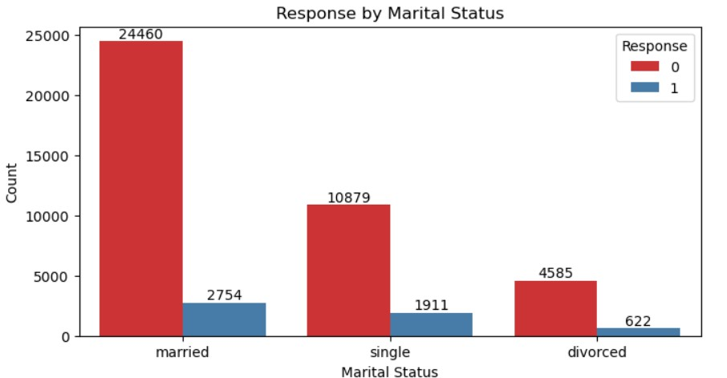
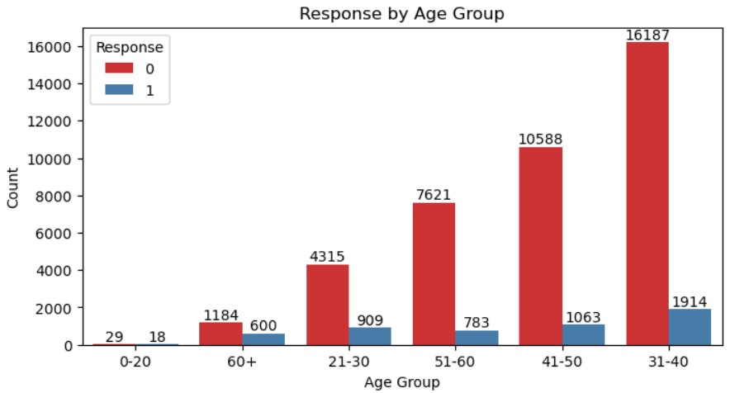
Marital Status and Age Group Analysis
Married people formed the largest group, with 24,460 'no' responses and 2,754 'yes' responses. All marital statuses showed consistently more 'no' responses than 'yes' responses. The age group 31-40 had the most people but still showed low engagement.
Recommendations include focusing marketing efforts on married customers with family-oriented products, conducting customer surveys to understand low 'yes' response rates, and creating personalized campaigns for the 31-40 age group. For younger (0-20) and older (60+) age groups, targeted campaigns with relevant content are suggested to increase engagement.
Family Focus
Customer Surveys
Age-Specific Campaigns
Target married customers with
family-oriented products
Understand reasons for low 'yes’
response rates
Personalized campaigns for different
age groups

Slide 8
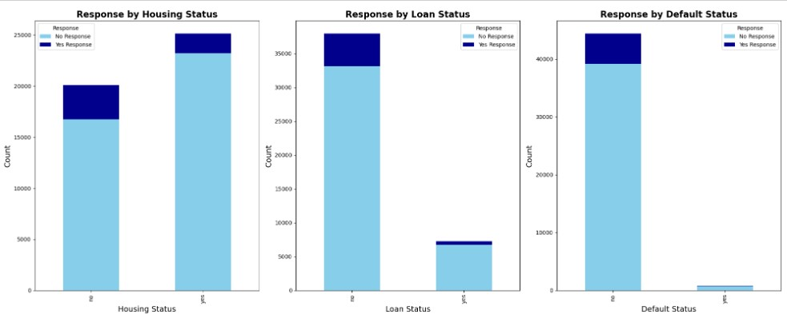
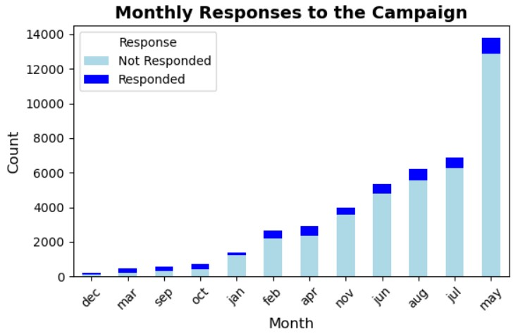
Loan and Temporal Analysis
Customers without loans were more likely to respond positively to the campaign, while those with a history of default were significantly less likely to respond positively. The analysis of monthly responses showed May (18.4%) and August (17.2%). as months with the highest positive responses while March and December had lower response rates.
Daily response rates varied, with peaks around day 1 (27%) and day 10 (22%), and lower rates (8-10%) during the middle of the month. Recommendations include focusing on debt-free customers, excluding those with default history, prioritizing campaigns in May and August, and scheduling more activities at the start of the month and around day 10.
January-April
May-August
September-December
Lower response rates, especially in March
Highest response rates, peak in May and August
Mixed response rates, lowest in December

Slide 9
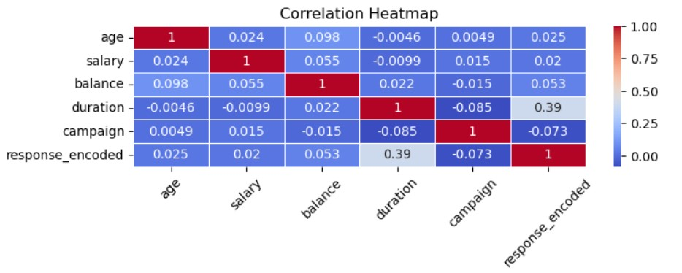
Correlation Analysis
Strong correlations were found between education and salary (0.43), age and marital status (-0.40), duration and response (0.39), and previous campaign and payment days (0.45). Most other correlations were weak. The strongest positive correlation with response was duration (0.39), while campaign showed a weak negative correlation (-0.073).
Recommendations include creating different financial products for education/salary segments, allowing for longer customer interactions, using education level as a key factor in marketing strategy, and focusing on the quality and duration of interactions rather than demographic factors for targeting.
1
Key Correlations
Education-Salary, Age-Marital Status,
Duration-Response
2
Response Factors
Duration most influential, weak impact
of demographics
3
Strategy Focus
Longer interactions, education-based segmentation, quality over quantity

Slide 10
Outlier Detection and Handling
Outliers were detected in age, salary, balance, duration, and campaign columns. After handling outliers using winsorization and IQR method, the data became more concentrated around typical values, with extreme outliers removed or adjusted. The cleaning process resulted in a loss of about 37% of the data.
Given the significant data loss, alternative methods like normalization or standardization should be considered for handling outliers in future analyses. This approach would help maintain a larger dataset while still addressing the impact of extreme values on the analysis.
Before vs After Cleaning
Feature
Before Cleaning
After Cleaning
Reduced extreme values in age, salary, balance, duration, and campaign
Age
Up to 90+ years
30-50 years
Data Loss
Salary
Up to 120,000
20,000-70,000
37% reduction in dataset size after outlier handling
Balance
Up to 100,000
0-3,500
Alternative Methods
Duration
Up to 80 minutes
1-10 minutes
Consider normalization or standardization for future analyses

Slide 11
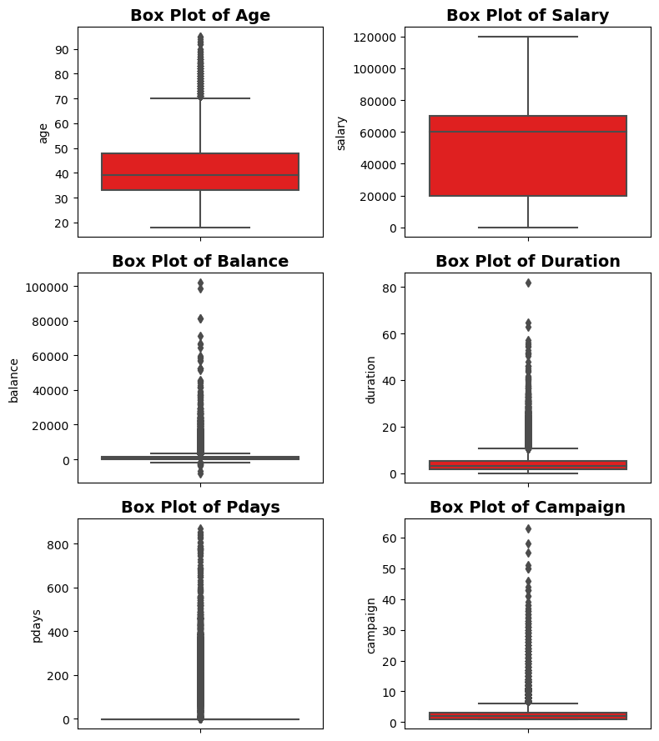
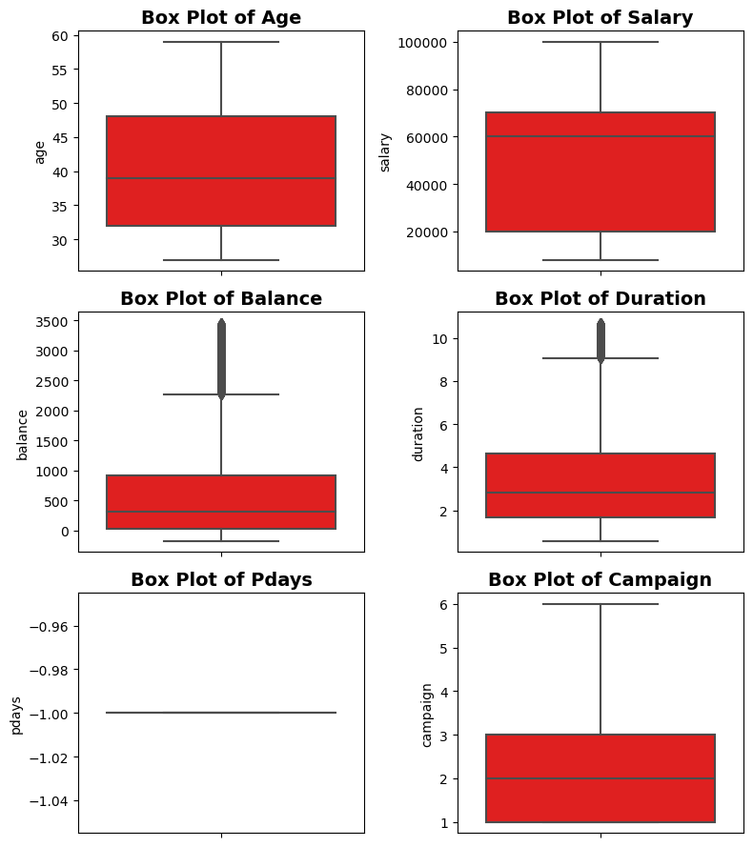
Before Handling Outliers
After Handling Outliers

Slide 12
Previous Campaign Analysis
1
Contact History
2
Findings
3
Recommendations
Single contact: 65%, Multiple contacts: 35%.
Diminishing returns after 3 contacts.
Maximum 3 attempts, optimize spacing between contacts.
Executive Summary
1
Campaign Overview
45,211 customer interactions analyzed.
2
Conversion Rate
11.7% success vs 88.3% failure.
3
Analysis Structure
Segment-by-segment analysis with actionable insights.
Vikas Singh

Slide 13




Campaign Optimization Strategies
Extend Call Duration
Optimize Timing
Train staff for longer, more meaningful customer interactions. Most calls are very
short
Focus on high-response months and days. Reduce mid-month campaigns.
Targeted Segmentation
Data-Driven Approach
Create strategies for different age groups and financial profiles.
Continuously analyze campaign data to refine strategies.
Timing Optimization
Frequency
Concentrate efforts on high-response months and days of the month.
Most customers receive 1-5 campaign contacts. More contacts slightly decrease positive -
responses.
.
Continuous Improvement
Personalization
Regularly analyze campaign data to refine strategies and improve conversion rates.
Tailor campaigns based on education, salary, and account balance.

